Slide 1
Quantifying the impacts of hospitals increasing single bed room provision
Andy Hood | Analytics Manager | Strategy Unit | 14th May 2024

Slide 2
Introduction, approach and summary

Slide 3
Introduction
Since it’s inception, the New Hospital Programme (NHP) has advocated for single bed rooms (SBR). The grounds for this are based on a range of guidance, evidence and previous policy statements of intent. Whilst that position is unequivocal, there is uncertainty around the quantification of impacts of such a change and thus the assumptions that feed into demand and capacity models and economic business cases for current and future new hospital developments.
Specifically, a starting assumption was that a length of stay reduction of 12% was likely for all new SBR facilities compared to prior trends. This assumption was criticised by the national audit office (NAO) (Office 2023) in the face of a mixed evidence base.
It is the express aim of this analysis therefore to quantify the range of likely impacts for length of stay and a basket of other measures across patient & staff experience, productivity and health & safety.

Slide 4
Approach
Previous literature reviews and general searches were undertaken to identify potential impact factors.
Identified relevant measures or proxy measures from publicly available data and routine data sources.
Included only those with sufficient time series and of acceptable data quality into final impact framework.
Cleansed and compiled all the data into time series format.
Identified ‘control’ sites and providers to compare to our natural experiment sites.
Several stages of this matching according to hospital function, size, case-mix and admission ratio’s.
Performed causal impact analysis on the pre and post intervention periods to detect the nature and scale of impacts for each natural experiment.
Aggregated findings for the non-specialist hospitals.

Slide 5
Summary of key findings
Regardless of direction of impact, our results are not consistent across hospital sites. This suggests that there are a number of other factors in the hospital design, systems, policies and procedures that are important. Switching to single bedroom hospitals without considering the other factors would not necessarily have a positive effect on outcomes nor mitigate any likely risks. This inconsistency is reflective of the findings from published literature.

Slide 6
The impact framework

Slide 7
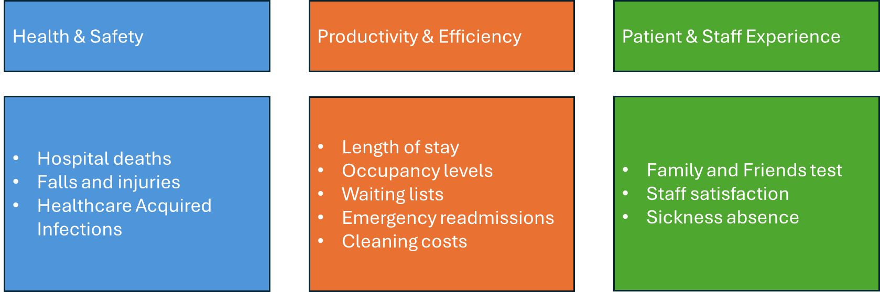
Overview

Slide 8
The hospitals

Slide 9
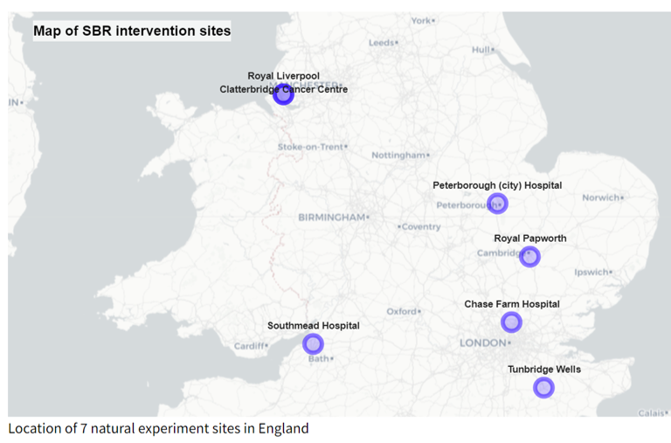
7 natural experiments
Royal Liverpool (Oct 2022)
Clatterbridge Cancer Centre (June 2020)
Royal Papworth Hospital (May 2019)
Chase Farm Hospital (Sept 2018)
Southmead Hospital (May 2014)
Tunbridge Wells (Jan/Sept 2011)
Peterborough Hospital (Nov 2010)

Slide 10
Summary of methods

Slide 11
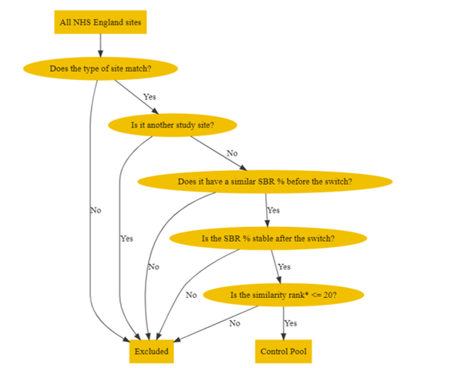
Selecting control sites
Before including control sites into the calculation of the post-intervention counterfactual, we must ensure they’re similar to the site under study. We do this in several consecutive steps:
Filter on similar site types e.g. General Acute, Tertiary Centre
Exclude those with dissimilar single bed %’s at the point of intervention
Match on (the closest 20) according to the following variables:
Hospital size (m2)
Patient case-mix (median age)
Elective:Non-elective spell ratio

Slide 12
Causal Impact Analysis

Slide 13
Aggregating impacts

Slide 14
Main results

